Slide 1
National Staff Survey 202 Results
You’ve Said – We Did

Slide 2
National Staff Survey 202 Results
You’ve Said – Together we’re doing

Slide 3
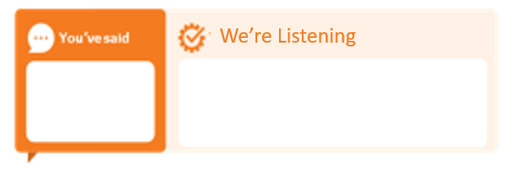
National Staff Survey 202 Results
You’ve Said – We’re Listening

